Slide 1
Surveying Sea Turtles
Eric Coyle, Isaiah Bluestein, and Madeline Frey

Slide 2

Dataset
NOAA Fisheries: Southeast Fisheries Science Center
Characterized North Carolina sea turtle populations from 1988 to 2015.

Slide 3
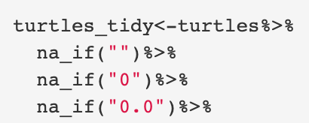
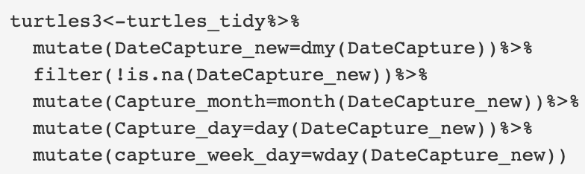
Initial Steps
Dealing with NA’s
Resolving Date issues and Cleaning Names

Slide 4
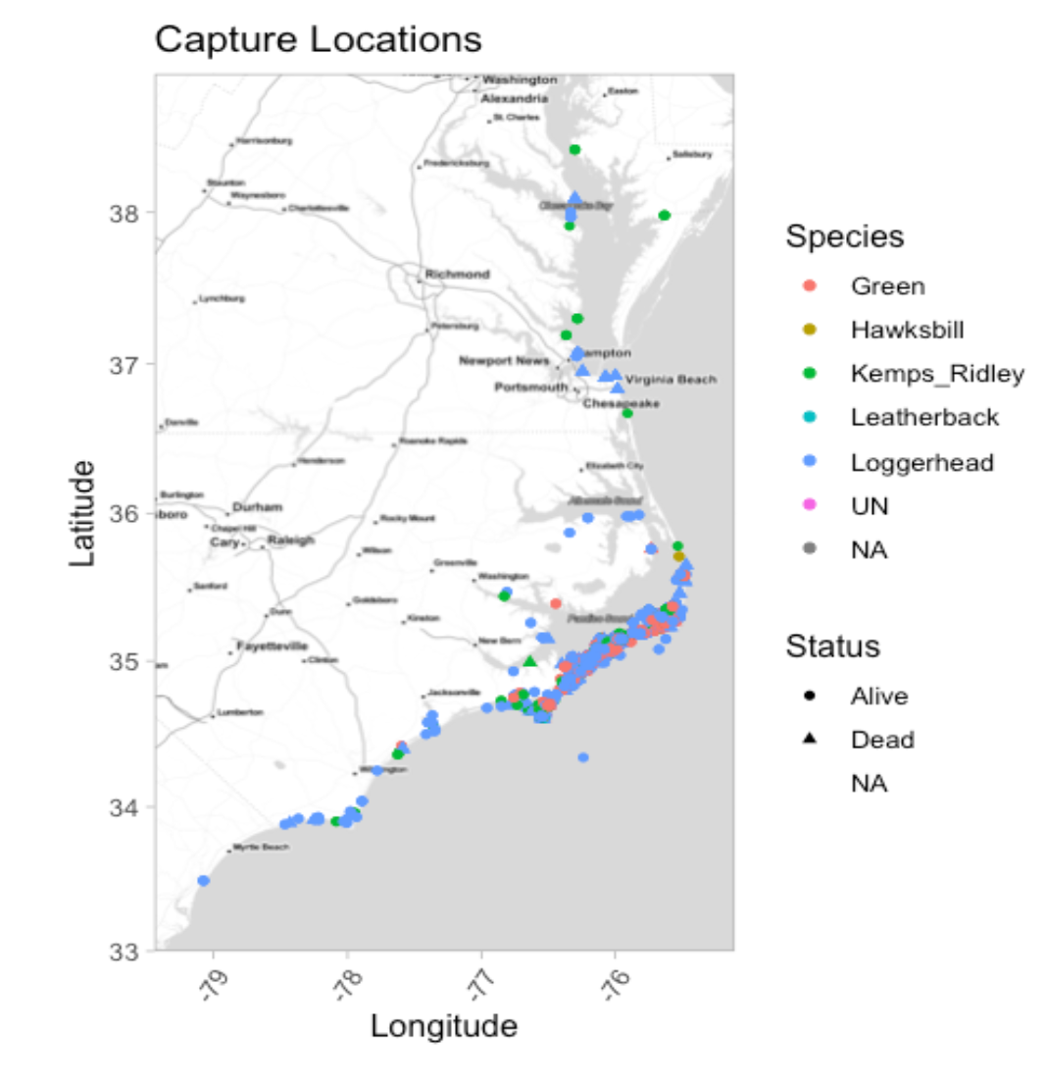
Where were turtles captured?

Slide 5
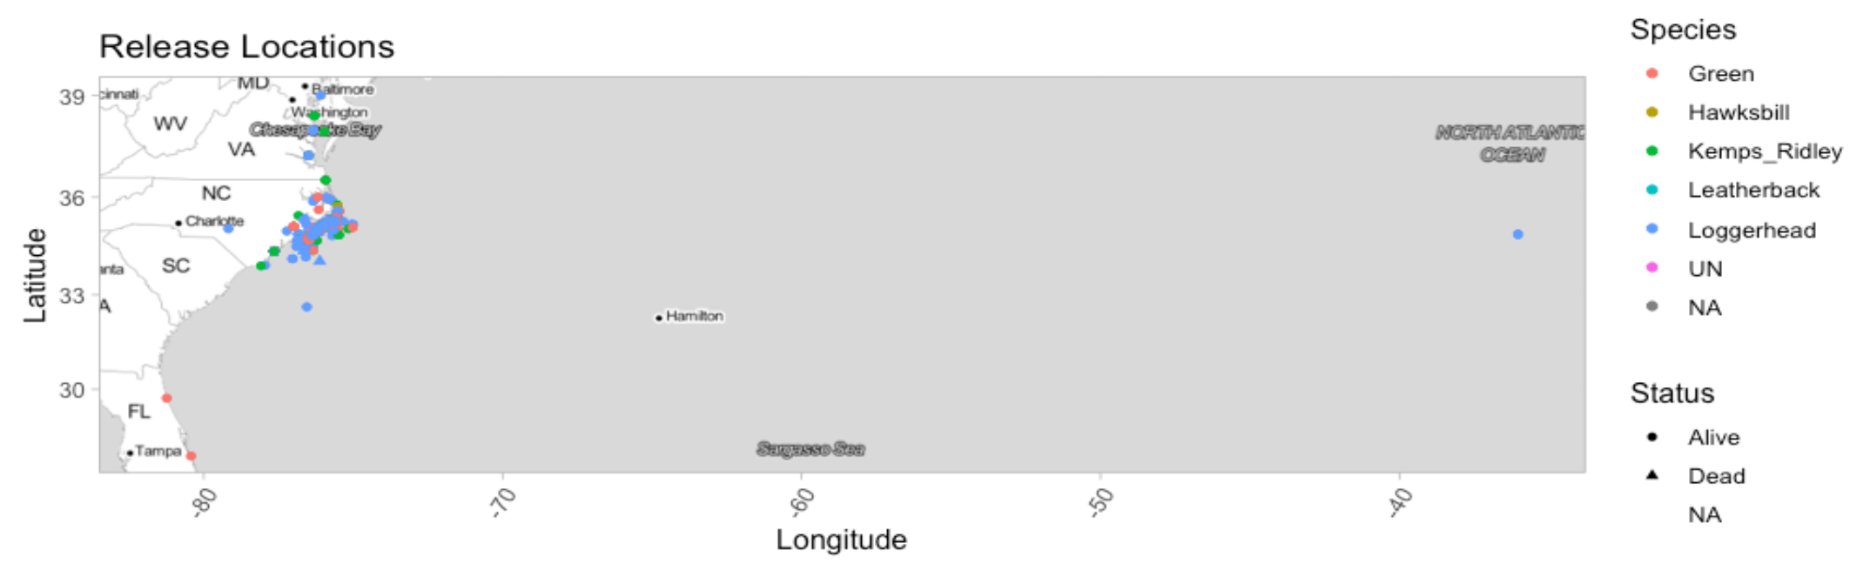
Where were turtles released?
One Loggerhead Outlier

Slide 6
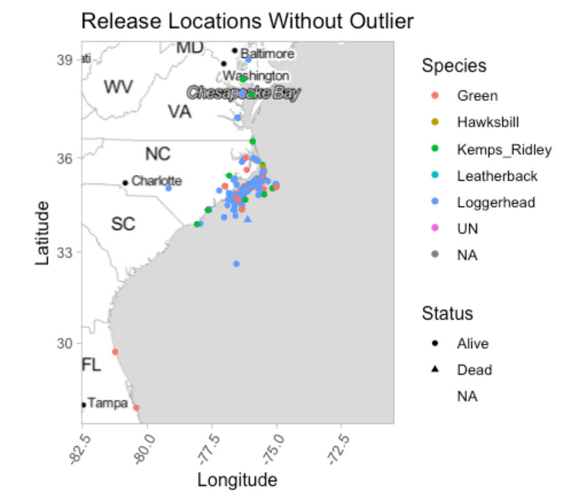
Where were turtles released?

Slide 7
Shiny Apps
Interactive Capture Map
Research types and methods by turtle species
Tests performed by species
Turtle measurements

Slide 8
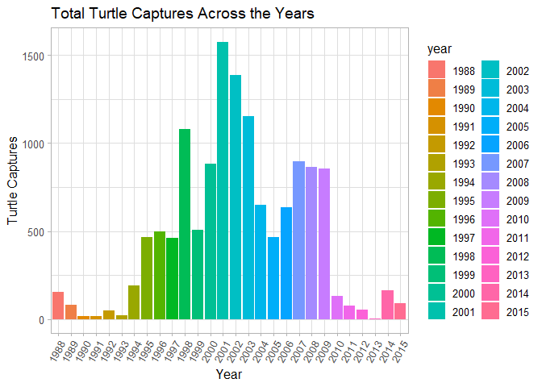
How did turtle captures change over time?

Slide 9
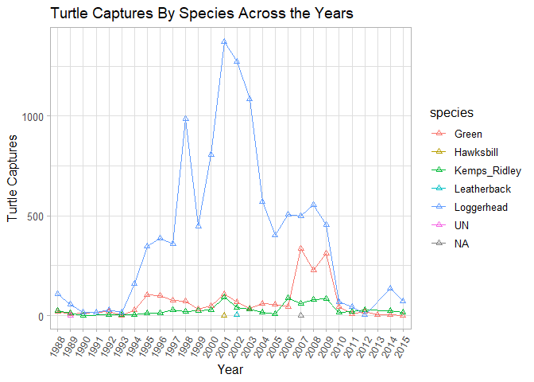
How did turtle captures change over time?

Slide 10
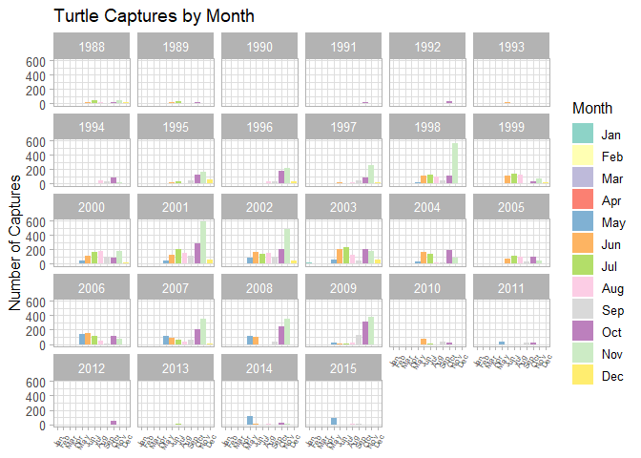
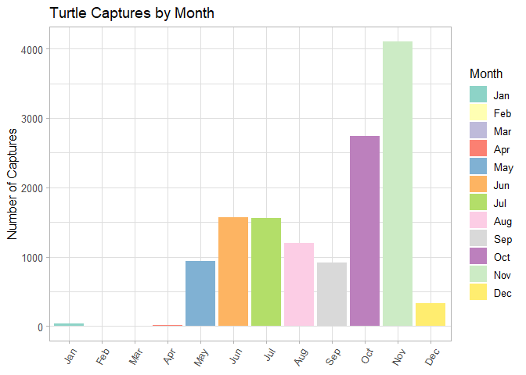
How did turtle captures change over time?

Slide 11
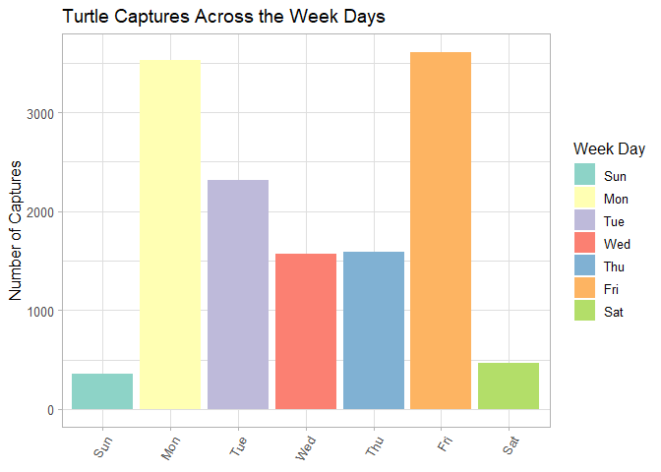
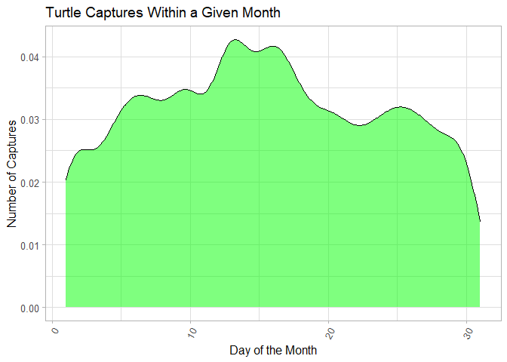
How did turtle captures change over time?

